Slide 1

Integration with Kafka

Slide 2


What is Kafka?
Data Streaming tool originally created by
Open-sourced, and now used by numerous companies, including Netflix, Goldman Sachs, Airbnb, and many others.
Can use receiver or receiver-less methods for connecting Kafka and Spark

Slide 3
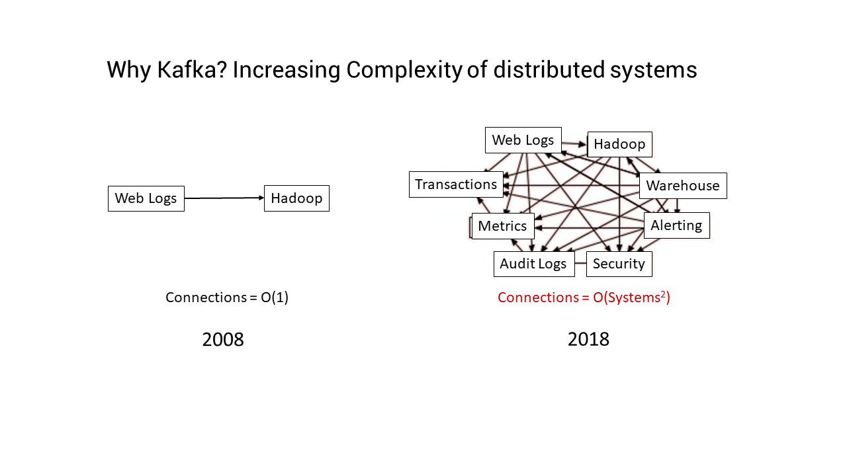

Slide 4
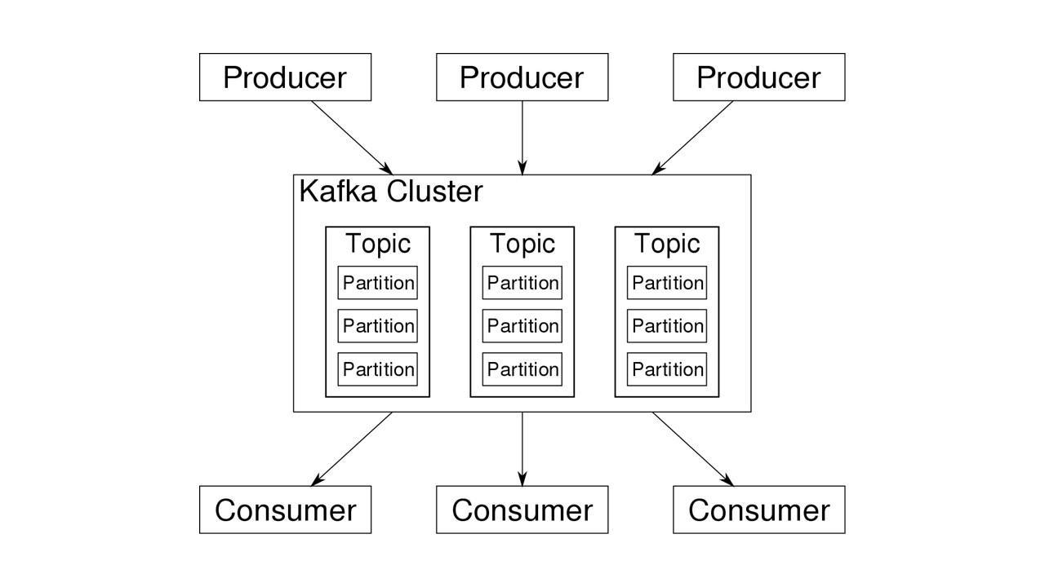

Slide 5

Steps to Using Kafka In Applications
Linking
For Python applications, you will have to add the below library and its dependencies when deploying an application
Full details are given in the Spark Programming guide at https://spark.apache.org/docs/2.2.0/streaming-programming-guide.html#linking
groupId = org.apache.spark
artifactId = spark-streaming-kafka-0-8-2.11
version = 2.2.0
Notes:
reduceByKeyAndWindow(func, windowLength, slideInterval, [numTasks])
When called on a DStream of (K, V) pairs, returns a new DStream of (K, V) pairs where the values for each key are aggregated using the given reduce function func over batches in a sliding window. Note: By default, this uses Spark's default number of parallel tasks (2 for local mode, and in cluster mode the number is determined by the config property spark.default.parallelism) to do the grouping. You can pass an optional numTasks argument to set a different number of tasks
reduceByKeyAndWindow(func, invFunc, windowLength, slideInterval, [numTasks])
A more efficient version of the above reduceByKeyAndWindow() where the reduce value of each window is calculated incrementally using the reduce values of the previous window. This is done by reducing the new data that enters the sliding window, and “inverse reducing” the old data that leaves the window. An example would be that of “adding” and “subtracting” counts of keys as the window slides. However, it is applicable only to “invertible reduce functions”, that is, those reduce functions which have a corresponding “inverse reduce” function (taken as parameter invFunc). Like in reduceByKeyAndWindow, the number of reduce tasks is configurable through an optional argument. Note that checkpointing must be enabled for using this operation.

Slide 6
Steps to Using Kafka In Applications
Programming
In the streaming application code, import kafkaUtils and create an output Dstream.
You can also specify the key and value classes and their corresponding decoder classes using variations of createStream
from pyspark.streaming.kafka import KafkaUtils
kafkaStream = KafkaUtils.createStream(streamingContext,[ZK quorum], [consumer group id], [per-topic number of Kafka partitions to consume])
Notes:
reduceByKeyAndWindow(func, windowLength, slideInterval, [numTasks])
When called on a DStream of (K, V) pairs, returns a new DStream of (K, V) pairs where the values for each key are aggregated using the given reduce function func over batches in a sliding window. Note: By default, this uses Spark's default number of parallel tasks (2 for local mode, and in cluster mode the number is determined by the config property spark.default.parallelism) to do the grouping. You can pass an optional numTasks argument to set a different number of tasks
reduceByKeyAndWindow(func, invFunc, windowLength, slideInterval, [numTasks])
A more efficient version of the above reduceByKeyAndWindow() where the reduce value of each window is calculated incrementally using the reduce values of the previous window. This is done by reducing the new data that enters the sliding window, and “inverse reducing” the old data that leaves the window. An example would be that of “adding” and “subtracting” counts of keys as the window slides. However, it is applicable only to “invertible reduce functions”, that is, those reduce functions which have a corresponding “inverse reduce” function (taken as parameter invFunc). Like in reduceByKeyAndWindow, the number of reduce tasks is configurable through an optional argument. Note that checkpointing must be enabled for using this operation.

Slide 7
Steps to Using Kafka In Applications
Deployment
spark-submit is used to launch application
For Python applications which lack SBT/Maven project management, spark-streaming-kafka-0-8_2.11 and its dependencies can be directly added to spark-submit using --packages
Notes:
reduceByKeyAndWindow(func, windowLength, slideInterval, [numTasks])
When called on a DStream of (K, V) pairs, returns a new DStream of (K, V) pairs where the values for each key are aggregated using the given reduce function func over batches in a sliding window. Note: By default, this uses Spark's default number of parallel tasks (2 for local mode, and in cluster mode the number is determined by the config property spark.default.parallelism) to do the grouping. You can pass an optional numTasks argument to set a different number of tasks
reduceByKeyAndWindow(func, invFunc, windowLength, slideInterval, [numTasks])
A more efficient version of the above reduceByKeyAndWindow() where the reduce value of each window is calculated incrementally using the reduce values of the previous window. This is done by reducing the new data that enters the sliding window, and “inverse reducing” the old data that leaves the window. An example would be that of “adding” and “subtracting” counts of keys as the window slides. However, it is applicable only to “invertible reduce functions”, that is, those reduce functions which have a corresponding “inverse reduce” function (taken as parameter invFunc). Like in reduceByKeyAndWindow, the number of reduce tasks is configurable through an optional argument. Note that checkpointing must be enabled for using this operation.

Slide 8
Things to Remember
Multiple Kafka input DStreams can be created with different groups and topics for parallel receiving of data using multiple receivers.
Kafka partitions and RDD partitions in Spark don’t always correlate. Increasing # of topic-specific partitions in KafkaUtils.createStream() only increases the number of threads using which topics that are consumed within a single receiver.
Doesn’t actually increase parallelism
If you have enabled Write Ahead Logs with a replicated file system like HDFS, the received data is already being replicated in the log.
Notes:
reduceByKeyAndWindow(func, windowLength, slideInterval, [numTasks])
When called on a DStream of (K, V) pairs, returns a new DStream of (K, V) pairs where the values for each key are aggregated using the given reduce function func over batches in a sliding window. Note: By default, this uses Spark's default number of parallel tasks (2 for local mode, and in cluster mode the number is determined by the config property spark.default.parallelism) to do the grouping. You can pass an optional numTasks argument to set a different number of tasks
reduceByKeyAndWindow(func, invFunc, windowLength, slideInterval, [numTasks])
A more efficient version of the above reduceByKeyAndWindow() where the reduce value of each window is calculated incrementally using the reduce values of the previous window. This is done by reducing the new data that enters the sliding window, and “inverse reducing” the old data that leaves the window. An example would be that of “adding” and “subtracting” counts of keys as the window slides. However, it is applicable only to “invertible reduce functions”, that is, those reduce functions which have a corresponding “inverse reduce” function (taken as parameter invFunc). Like in reduceByKeyAndWindow, the number of reduce tasks is configurable through an optional argument. Note that checkpointing must be enabled for using this operation.

